Slide 1
Unity Ad Plugin

Slide 2
CHECK
Make sure that your game is switched to ANDROID PLATFORM

Slide 3
Learning outcome
Integrating the Google Mobile Ads Unity plugin into an app, which you will do here, is the first step toward displaying AdMob ads and earning revenue.
Once the integration is complete, you can choose an ad format (such as native or rewarded video) to get detailed implementation steps.

Slide 4
Prerequisites
Use Unity 2018.4 or higher
To deploy to Android
Google Play Services 18.1.0 or higher
Target Android API level 16 or higher
Recommended: Create an AdMob account and register an Android and/or iOS app

Slide 5
Download the Mobile Ads Unity plugin
The Google Mobile Ads Unity plugin enables Unity developers to easily serve Google Mobile Ads on Android and iOS apps without having to write Java or Objective-C code.
The plugin provides a C# interface for requesting ads that is used by C# scripts in your Unity project.
Use the links below to download the Unity package for the plugin or to take a look at its code on GitHub.
https://github.com/googleads/googleads-mobile-unity/releases
Download Unity ad plugin from assets option
Install Advertisement Legacy in Unity Package Manager

Slide 6
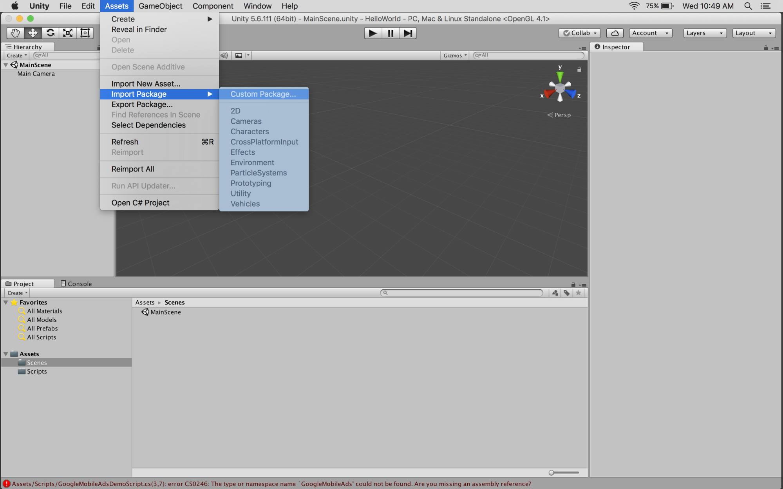
Import the Mobile Ads Unity plugin
Open your project in the Unity editor.
Select Assets > Import Package > Custom Package and
Find the GoogleMobileAdsPlugin.unitypackag file you downloaded
Click import by selecting all files

Slide 7
Include the Mobile Ads SDK
The Google Mobile Ads Unity plugin is distributed with the Unity Play Services Resolver library.
This library is intended for use by any Unity plugin that requires access to Android specific libraries (e.g., AARs) or iOS CocoaPods.
It provides Unity plugins the ability to declare dependencies, which are then automatically resolved and copied into your Unity project.

Slide 8
Follow the steps listed below to ensure your project includes the Mobile Ads SDK.
In the Unity editor, select Assets > External Dependency Manager > Android Resolver > Resolve.
The Unity External Dependency Manager library will copy the declared dependencies into the Assets/Plugins/Android directory of your unity app

Slide 9
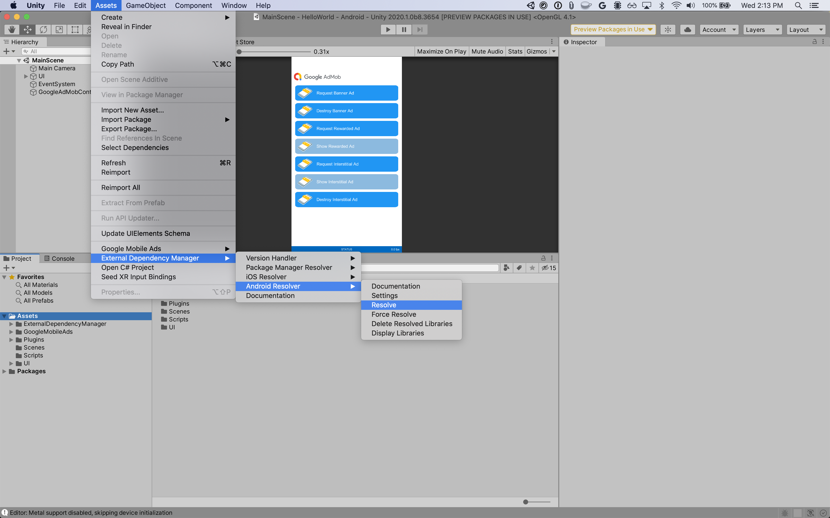

Slide 10
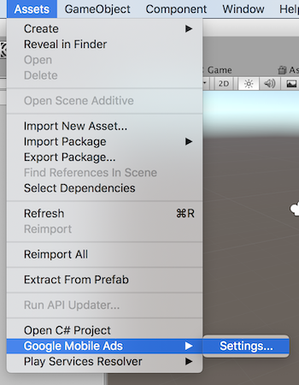
Set your AdMob app ID
In the Unity editor, select Assets > Google Mobile Ads > Settings from the menu

Slide 11
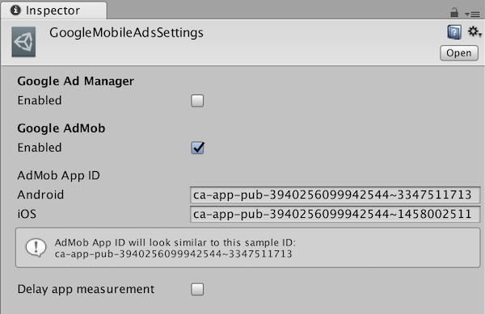
Enable AdMob by clicking Enabled checkbox under Google AdMob section. Then enter your Android and iOS AdMob app ID in each field

Slide 12
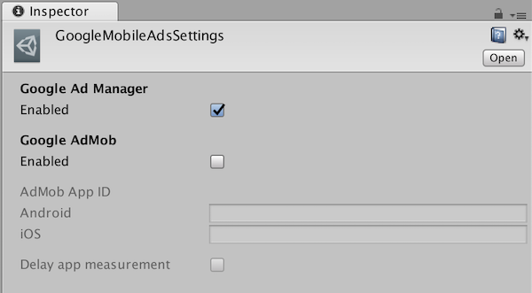
For some versions
If your app uses Ad Manager instead of AdMob, enable Google Ad Manager by clicking Enabled checkbox under Google Ad Manager section

Slide 13
Initialize the Mobile Ads SDK
Before loading ads, have your app initialize the Mobile Ads SDK by calling MobileAds.Initialize()
This needs to be done only once, ideally at app launch

Slide 14
Here's an example of how to call Initialize()
... using GoogleMobileAds.Api; ... public class GoogleMobileAdsDemoScript : MonoBehaviour { public void Start() { // Initialize the Google Mobile Ads SDK. MobileAds.Initialize(initStatus => { }); } }

Slide 15
Select an ad format
The Mobile Ads SDK is now included in your Unity app when deploying to either the Android or iOS platform.
You're now ready to implement an ad.
AdMob offers a number of different ad formats, so you can choose the one that best fits your user experience needs

Slide 16
Banner
Banner ads are rectangular image or text ads that occupy a spot within an app's layout.
They stay on screen while users are interacting with the app, and can refresh automatically after a certain period of time.
If you're new to mobile advertising, they're a great place to start
Link:
https://developers.google.com/admob/unity/banner

Slide 17
Native
Native is a component-based ad format that gives you the freedom to customize the way assets such as headlines and calls to action are presented in their apps.
By choosing fonts, colors, and other details for yourself, you can create natural, unobtrusive ad presentations that can add to a rich user experience
Link:
https://developers.google.com/admob/unity/native-advanced-unified

Slide 18
Rewarded
Rewarded video ads are full-screen video ads that users have the option of watching in full in exchange for in-app rewards
Link:
https://developers.google.com/admob/unity/rewarded

Slide 19
END

